Slide 1
Weekly Presentation: Rotor Bearing System
Week number: 03
Date: 14/10/2025
Supervisor: Prof. Quell
Group members: Divyesh Mistry, Venkata Sreekanth .K , Sreehari Padachery, Jill Sadariya
Presenter : Divyesh Mistry
Rotor Bearing System / Optimus Syria

Slide 2
Agenda
Task of the week.
Comparing the opinions.
Solution for Negative Aspects in Journal Bearings
Load equilibrium of 3-point suspension system.
Rotor Shaft design procedure.
GL Standards for Rotor Lock.
Recommended Rotor Lock.
Bibliography.
Divyesh Mistry
Rotor Bearing System / Optimus Syria

Slide 3
Task of the week
Contacted couple of bearing manufactures (SKF & Schaeffler) and some experts regarding spherical journal bearing suited for 5MW.
Analyzed Force-Momentum diagram of current rotor bearing system.
Studied Rotor Shaft calculation and Solution from previous year projects.
Divyesh Mistry

Slide 4
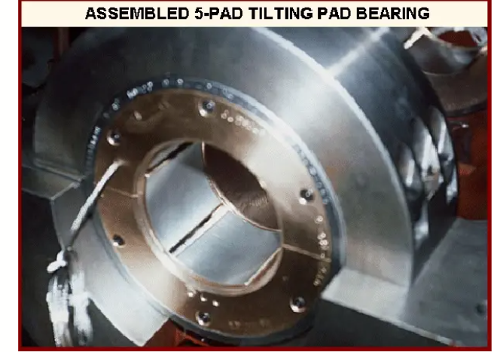

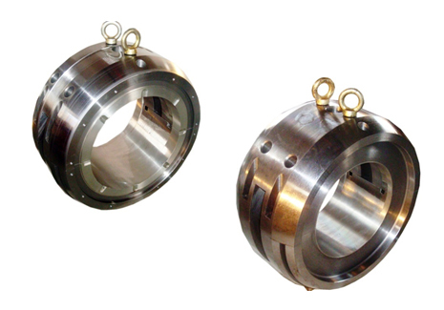

Comparing the opinions
1. Received feed back from bearing manufacturer in the UK “Michell Bearings”.
They suggested that a spherical journal bearing in bigger size may not an option.
They told to go for Tilting journal pads
2. One possible option as sliding bearing, could be the so called "white metal" bearings which are used in Gas turbines. Suggested by Howatech.
Source : Sajid, Z. (n.d.). Tilting pad. Scribd.
Source : Mangal Industry.
Divyesh Mistry

Slide 5
Solution for Negative Aspects in Journal Bearings
Negative Aspect | Cause / Limitation | Solution / Mitigation Strategy
High friction during startup (Hydrodynamic Bearing) | No hydrodynamic oil film at low or zero speed. | • Use hydrostatic lift assist system to supply pressurized oil during startup/shutdown. • Apply low-friction coatings (e.g., DLC, Triondur OC). • Use optimized bearing geometry to form film faster.
Load capacity depends on rotational speed (Hydrodynamic Bearing) | Oil film thickness builds up only with shaft rotation. | • Combine hybrid design: hydrodynamic + hydrostatic support. • Use variable viscosity oils or active lubrication control.
System complexity (Hydrostatic Bearing) | Requires external pump, filters, piping, controls. | • Integrate compact, modular pump units inside nacelle. • Use smart monitoring systems for pressure and flow. • Employ reliable self-contained lubrication cartridges.
Divyesh Mistry

Slide 6
Solution for Negative Aspects in Journal Bearings
High CAPEX (Hydrostatic Bearing) | Expensive pumps, control systems, and precision components. | • Use shared lubrication systems for multiple bearings. • Optimize bearing design and materials (e.g., polymer liners, ceramic coatings). • Focus on life-cycle cost savings—less downtime offsets higher CAPEX.
High OPEX (Hydrodynamic Bearing) | Frequent oil maintenance and monitoring required. | • Implement automated lubrication systems. • Use condition monitoring sensors (temperature, pressure, vibration). • Select long-life synthetic lubricants.
Complex external lubrication controls (Hydrostatic) | Separate systems for each bearing increase control difficulty. | • Use centralized lubrication and control systems. • Integrate digital predictive maintenance (IoT-based).
Divyesh Mistry

Slide 7
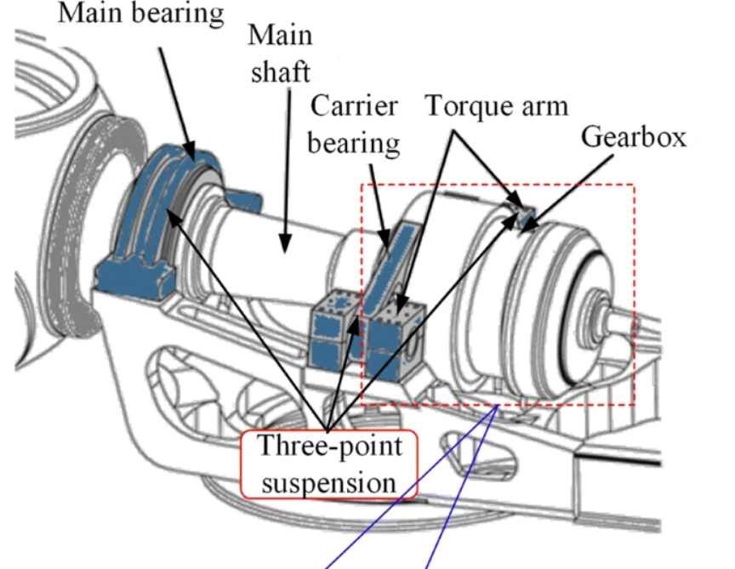
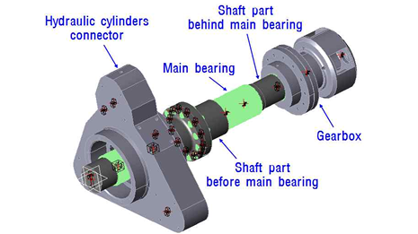
Three point suspension system
Source : Nam, J. S., & Nam, Y. Y. (2015). Influence of suspension stiffness on gearbox loads. J. Korean Soc. Manuf. Technol. Eng., 24(5), 514–520.
Source : Tan et al. (2019), Main shaft flexibility effects on wind turbine drivetrain..
Divyesh Mistry

Slide 8
Loads equilibrium of 3-point suspension system
F_{ZR}​
F_{ZA}​
F_{S}s
F_{G} s
F_{YR}​
F_{YA}​
M_{ZR}​
M_{YR}​
Rotor
F_{XR}​
F_{XA}​
Gear Box
Shaft C.G
M_{XR}​
Bearing A
L₁
L_{S}
L_{G}
Divyesh Mistry

Slide 9
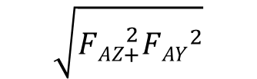
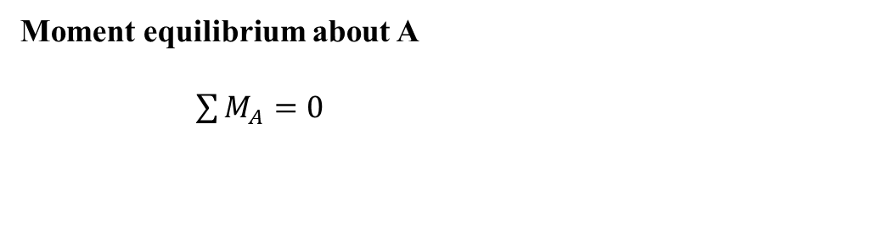
Loads equilibrium of 3-point suspension system
Equilibrium for forces:
F_{AX}= - F_{RX}
F_{AZ} = - F_{RZ} + F_{RZ} + F_{S} + F_{G}
F_{AY}= - F_{RY}
F_{S} :Shaft gravitational force.
F_{G} : Gearbox gravitational force.
F_{A} : Radial Forces in (Y, Z) direction for Bearing A
F_{XR}​ : Force in X-direction at the hub
F_{YR} : Force in Y-direction at the hub
F_{ZR} : Force in Z-direction at the hub
M_{XR} : Moment in X-direction at hub
M_{YR} : Moment in Y-direction at hub
M_{ZR} : Moment in Z-direction at hub
Moment equilibrium about A
$\sum{M_{A}}=0$
M_{A}= - F_{RX}-F_{RZ}*l₁+F_{S}*(l_{S} -l₁) +F_{G} *(l_{G} -l₁)
Resulting force 𝐹𝐴,𝑟𝑒𝑠 acting at the main bearing point A
$$\sqrt{{FAZ}_{+}^{2}{FAY}^{2}}$$
F_{Aresult}=
Divyesh Mistry

Slide 10
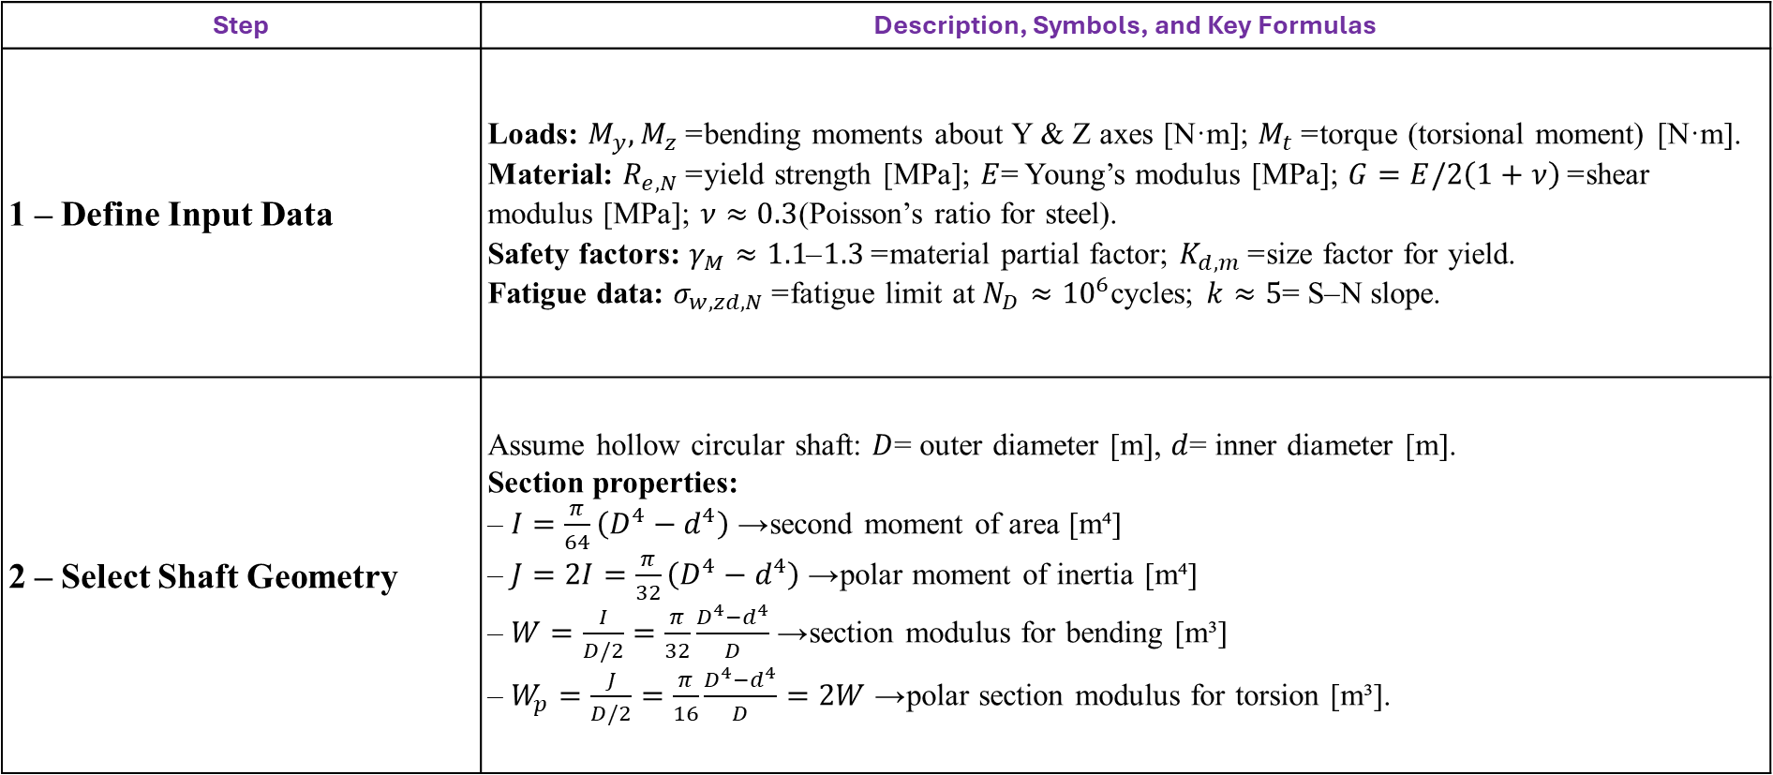
Rotor Shaft Design Procedure
Step | Description, Symbols, and Key Formulas
1 – Define Input Data | Loads: $M_{y},M_{z}$= bending moments about Y & Z axes [N·m]; $M_{t}$= torque (torsional moment) [N·m]. Material: $R_{e,N}$= yield strength [MPa]; $E$= Young’s modulus [MPa]; $G=E/2\left(1+ν\right)$= shear modulus [MPa]; $ν≈0.3$(Poisson’s ratio for steel). Safety factors: $γ_{M}≈1.1\text{–}1.3$= material partial factor; $K_{d,m}$= size factor for yield. Fatigue data: $σ_{w,zd,N}$= fatigue limit at $N_{D}≈{10}^{6}$cycles; $k≈5$= S–N slope.
2 – Select Shaft Geometry | Assume hollow circular shaft: $D$= outer diameter [m], $d$= inner diameter [m]. Section properties: – $I=\frac{π}{64}\left(D^{4}−d^{4}\right)$→ second moment of area [m⁴] – $J=2I=\frac{π}{32}\left(D^{4}−d^{4}\right)$→ polar moment of inertia [m⁴] – $W=\frac{I}{D/2}=\frac{π}{32}\frac{D^{4}−d^{4}}{D}$→ section modulus for bending [m³] – $W_{p}=\frac{J}{D/2}=\frac{π}{16}\frac{D^{4}−d^{4}}{D}=2W$→ polar section modulus for torsion [m³].
Divyesh Mistry

Slide 11
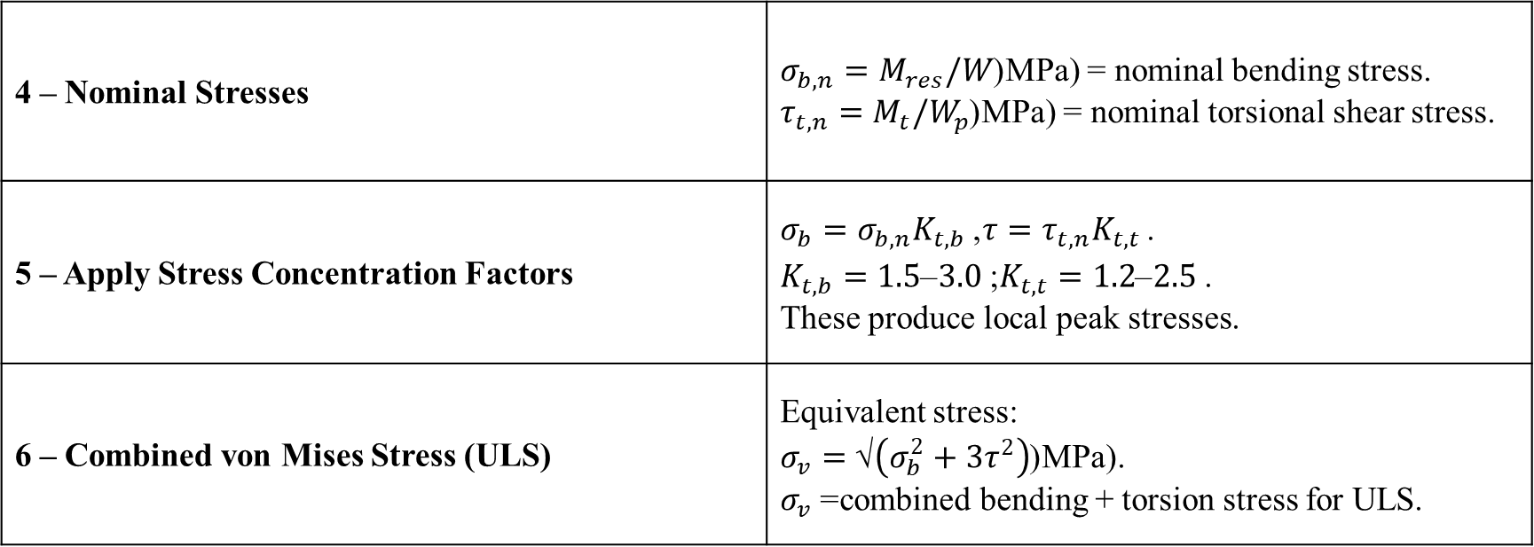
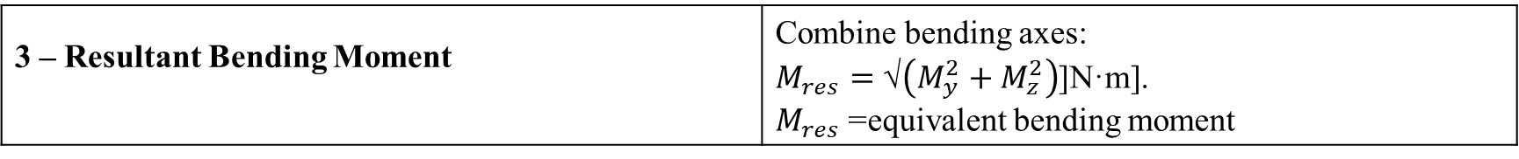
Rotor Shaft Design Procedure
3 – Resultant Bending Moment | Combine bending axes: $M_{res}=\text{√}\left(M_{y}^{2}+M_{z}^{2}\right)$[N·m]. $M_{res}$= equivalent bending moment
.
4 – Nominal Stresses | $σ_{b,n}=M_{res}/W$(MPa) = nominal bending stress. $τ_{t,n}=M_{t}/W_{p}$(MPa) = nominal torsional shear stress.
5 – Apply Stress Concentration Factors | $σ_{b}=σ_{b,n}K_{t,b}$, $τ=τ_{t,n}K_{t,t}$. $K_{t,b}=1.5\text{–}3.0$; $K_{t,t}=1.2\text{–}2.5$. These produce local peak stresses.
6 – Combined von Mises Stress (ULS) | Equivalent stress: $σ_{v}=\text{√}\left(σ_{b}^{2}+3τ^{2}\right)$(MPa). $σ_{v}$= combined bending + torsion stress for ULS.
Divyesh Mistry

Slide 12
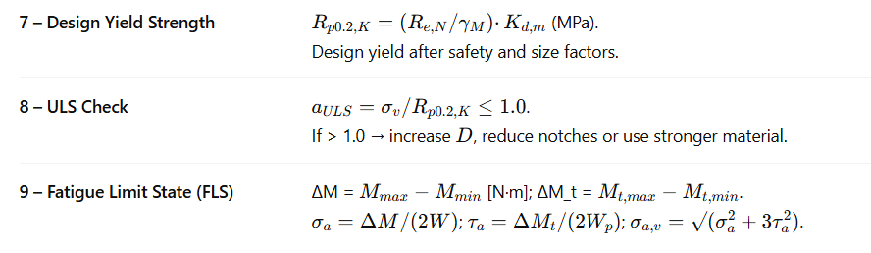
Rotor Shaft Design Procedure
7 – Design Yield Strength
8 – ULS Check
9 – Fatigue Limit State (FLS)
Divyesh Mistry

Slide 13
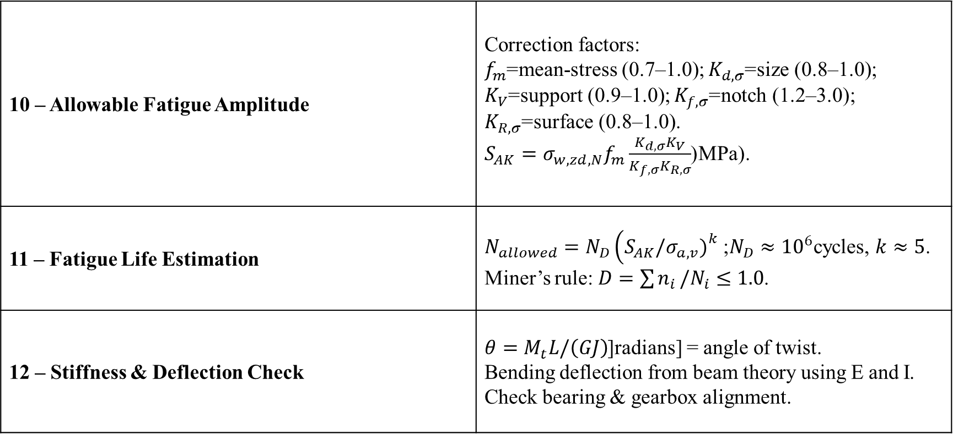
Rotor Shaft Design Procedure
10 – Allowable Fatigue Amplitude | Correction factors: $f_{m}$=mean-stress (0.7–1.0); $K_{d,σ}$=size (0.8–1.0); $K_{V}$=support (0.9–1.0); $K_{f,σ}$=notch (1.2–3.0); $K_{R,σ}$=surface (0.8–1.0). $S_{AK}=σ_{w,zd,N}f_{m}\frac{K_{d,σ}K_{V}}{K_{f,σ}K_{R,σ}}$(MPa).
11 – Fatigue Life Estimation | $N_{allowed}=N_{D}\left(S_{AK}/σ_{a,v}{\left.)\right.}^{k}\right.$; $N_{D}≈{10}^{6}$cycles, $k≈5$. Miner’s rule: $D=\sum{n_{i}}/N_{i}≤1.0$.
12 – Stiffness & Deflection Check | $θ=M_{t}L/\left(GJ\right)$[radians] = angle of twist. Bending deflection from beam theory using E and I. Check bearing & gearbox alignment.
Divyesh Mistry

Slide 14
GL Standards for Rotor Lock
GL (Germanischer Lloyd)(GL & IEC 61400-1)
Function: Secures rotor against rotation during maintenance, erection, or emergency.
Type: Form-fit design (e.g., pin-disc) preferred for reliability.
Load Capacity: Must withstand high transverse/gust loads (DLC 8.1, 8.2).
Strength Check: Verify shear, bending, and surface pressure; no plastic deformation.
Safety: Must prevent rotation even if brakes fail; safe manual release required.
Monitoring: Include non-contact or fail-safe position sensors.
Environment: Operate from –30 °C to +70 °C; corrosion-resistant (DIN ISO 12944).
Certification: Designed and tested per GL “Guideline for Certification of Wind Turbines.”
Maintenance: Periodic inspection and documentation required
Divyesh Mistry

Slide 15
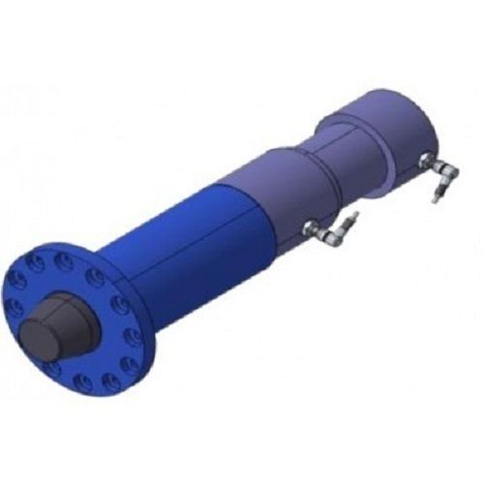
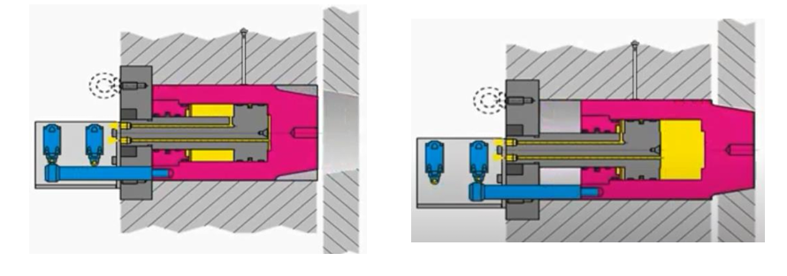
Rotor Lock
Lock Pin Hydraulic Mechanism
Source : IPC WIND
Sibre Rotor Lock RLH 80
Sibre Rotor Locks to assist the braking functions on practically any rotor on the Wind Turbine market.
The Sibre Wind Turbine Rotor Lock RLH 80 is a hydraulically applied, form-closed lock for wind turbine rotors
Source : Optimus Shakti
Divyesh Mistry

Slide 16
Bibiliography
International Electrotechnical Commission (IEC). (2005). IEC 61400-1: Wind turbines – Part 1: Design requirements (3rd ed.). Geneva, Switzerland: IEC. ISBN 2-8318-8215-2. Available at: https://webstore.iec.ch/publication/6027Germanischer Lloyd (GL). (2010).
Guideline for the Certification of Wind Turbines. Hamburg, Germany: Germanischer Lloyd Industrial Services GmbH, Renewables Certification. Available at: https://www.dnv.com/services/guideline-for-the-certification-of-wind-turbines-1602
Tan, J., Zhu, C., Song, C., Han, H., & Li, Y. (2019). Effects of Flexibility and Suspension Configuration of Main Shaft on Dynamic Characteristics of Wind Turbine Drivetrain. Chinese Journal of Mechanical Engineering, 32(36).https://doi.org/10.1186/s10033-019-0348-4Nam, J. S., & Nam, Y. Y. (2015).
The Influence of Suspension Stiffness on the Gearbox Input Loads in a 3-Point Suspension Wind Turbine Drive Train. Journal of the Korean Society of Manufacturing Technology Engineers, 24(5), 514–520.https://doi.org/10.7735/ksmte.2015.24.5.514
Divyesh Mistry

